Slide 3
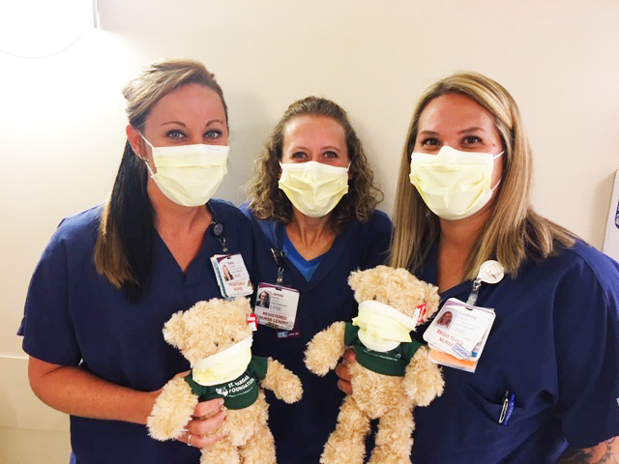
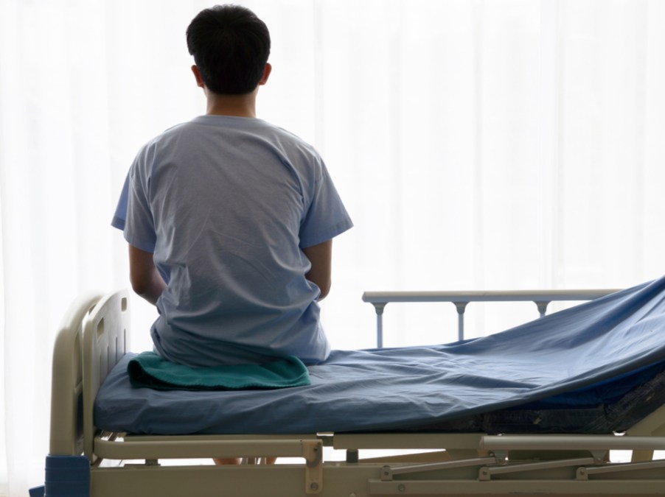
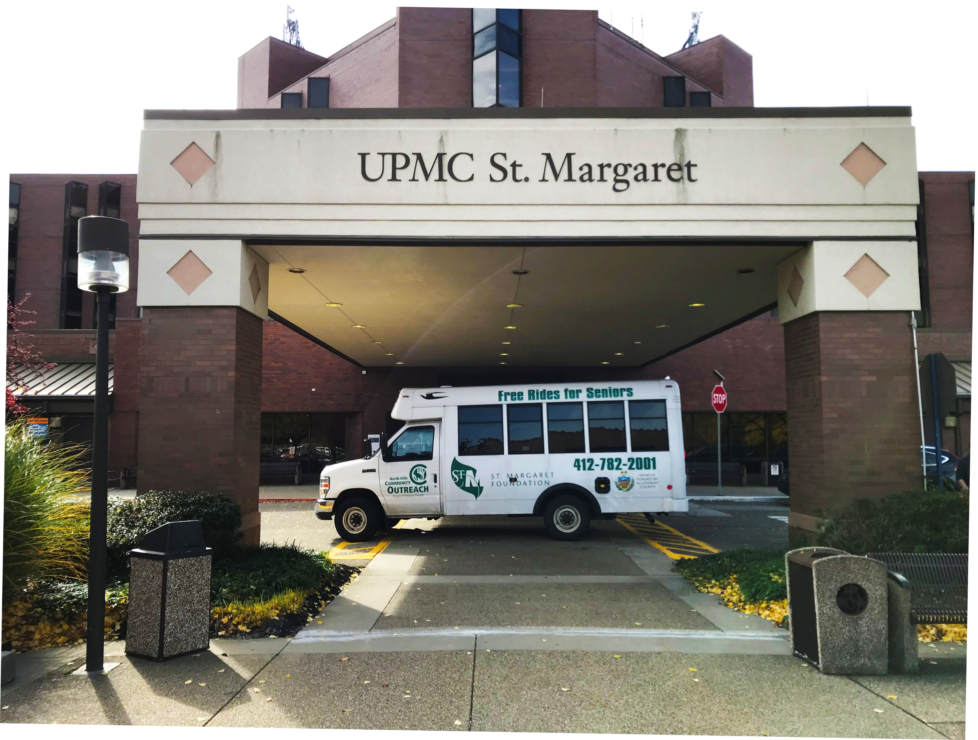
Why do we exist?
The reason we exist is because when you’re sick it’s difficult enough without having to worry if you have a ride to chemotherapy or treatment, or if you can pay for the expensive medicine, home oxygen, walkers, insulin, and other items you need that aren’t covered by insurance. Your gift fills in those heartbreaking gaps of suffering with hope and healing for patients at St. Margaret. We thank you on their behalf.
Filling in the gaps with hope.

Slide 5
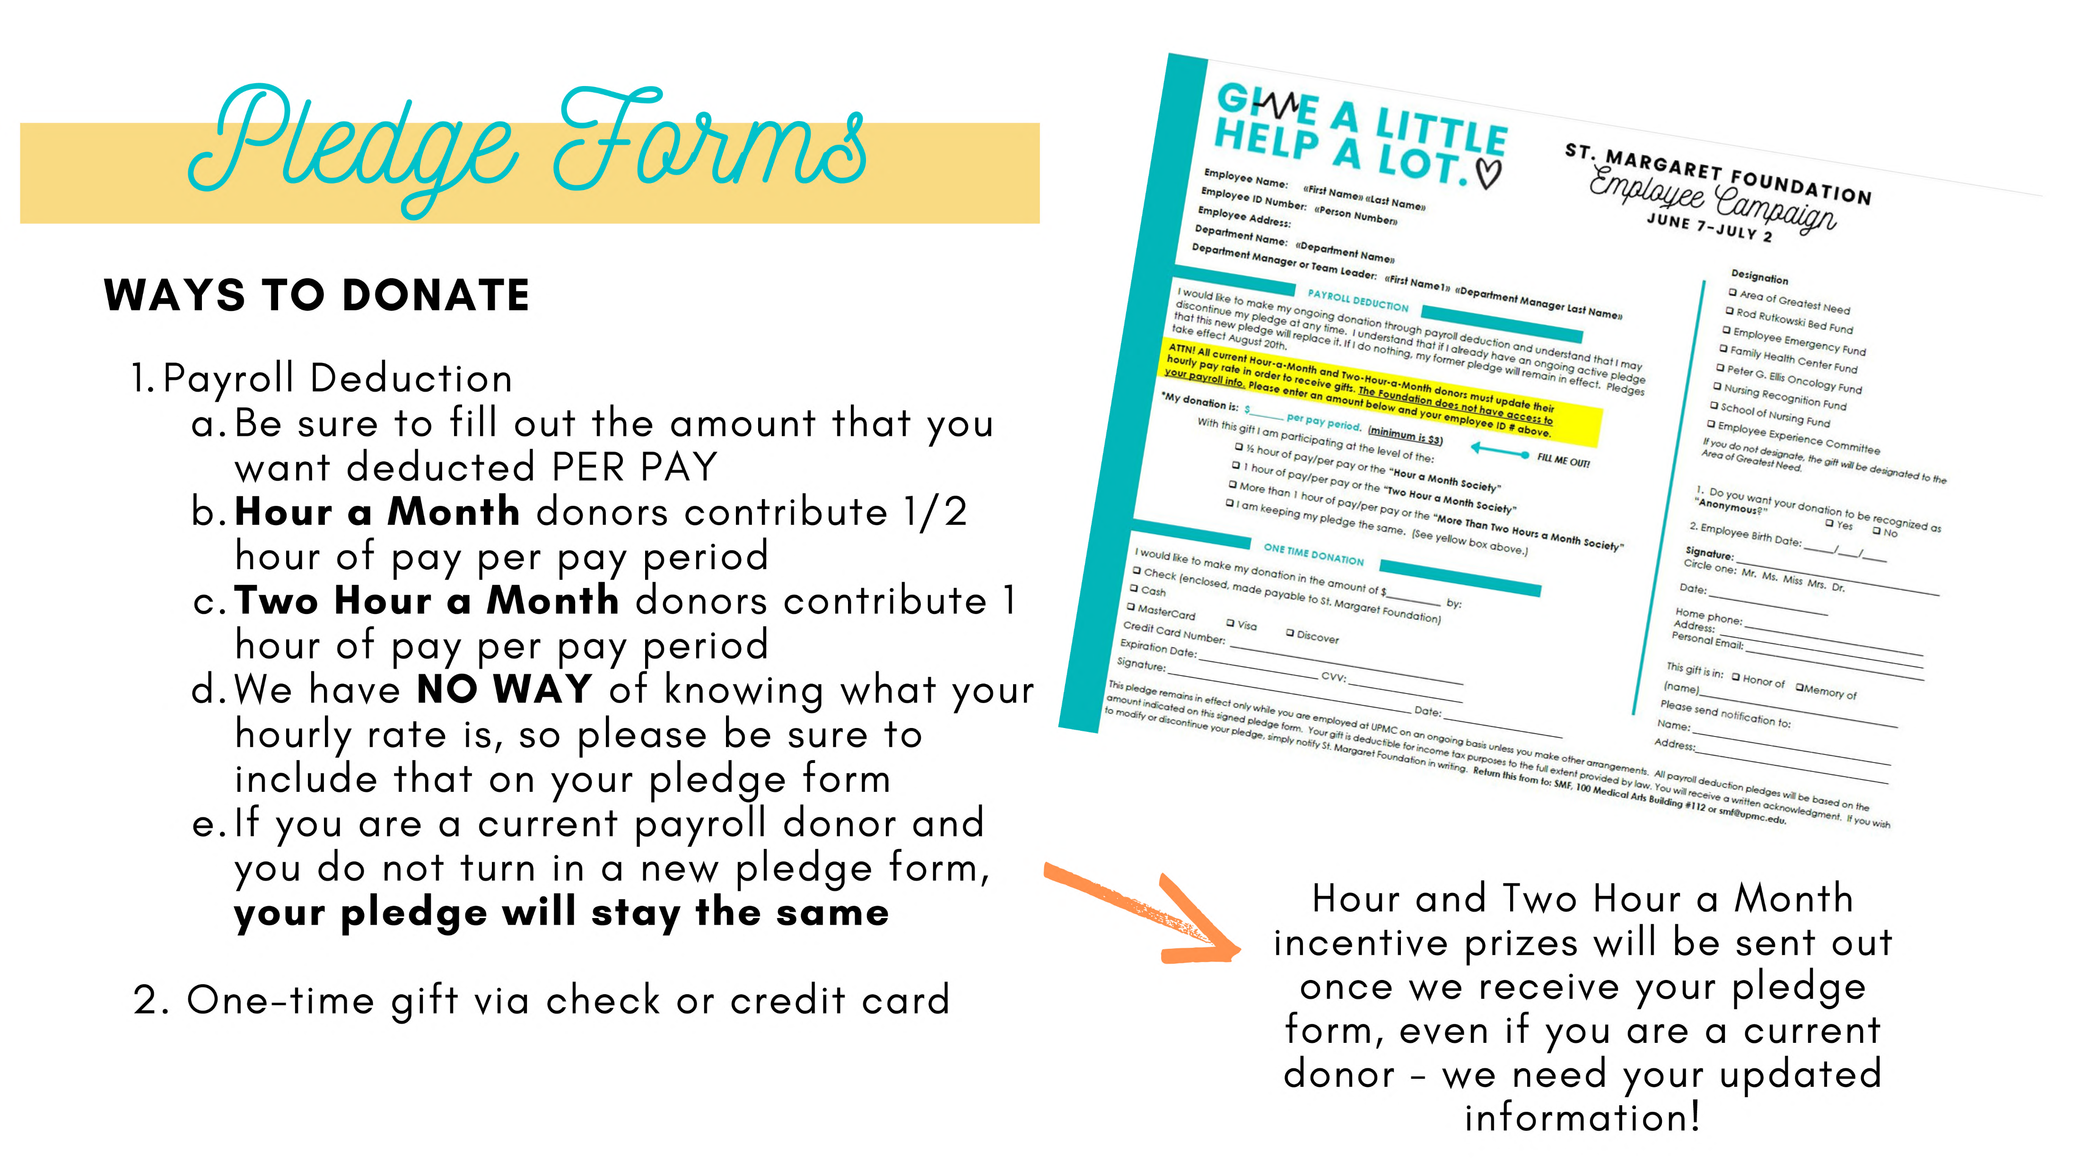

Slide 7
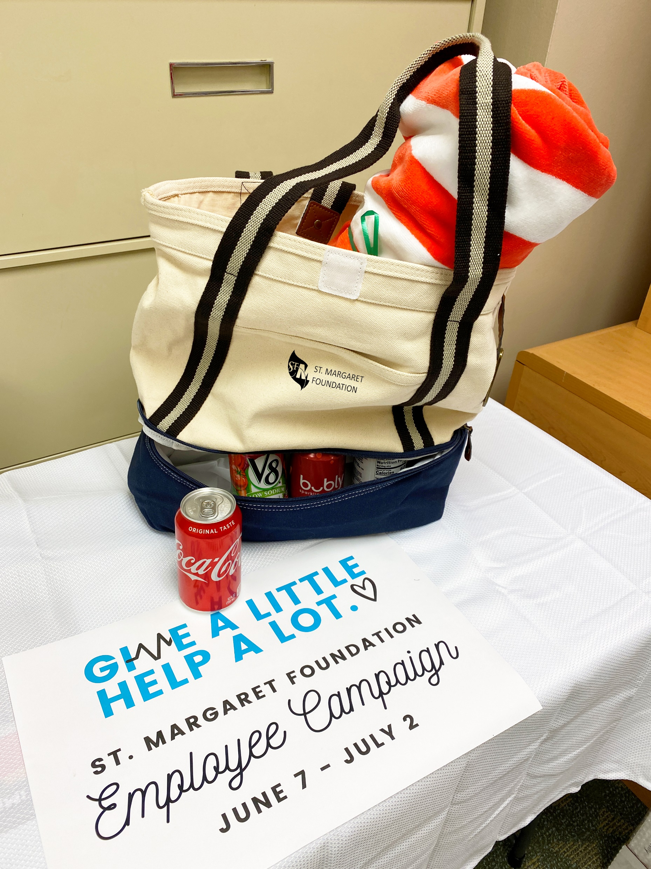
$3 a pay or
$40 once.
2 Hour-a-month.
Hour-a-month.
GET THEM
ALL!

Slide 8
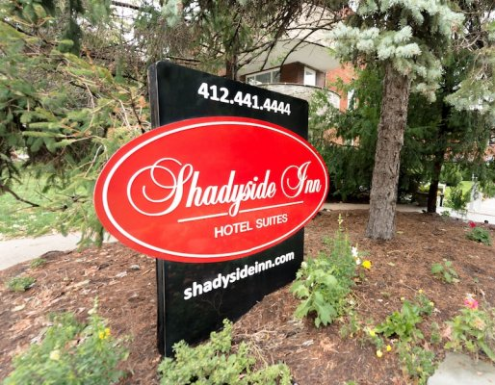
If we
See This!
You Would get!

Slide 9
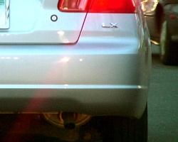
SPOTTED!
Donate $40 or more to receive a SMF Car Magnet that wins you prizes!
During this year’s campaign, SMF Staff will be checking the Employee Parking lot twice a week for cars displaying this magnet! If your car is spotted, you will receive an St. Margaret Foundation tote bag!!
If we
Spot This!
You get!
Or other Foundation prize

Slide 10
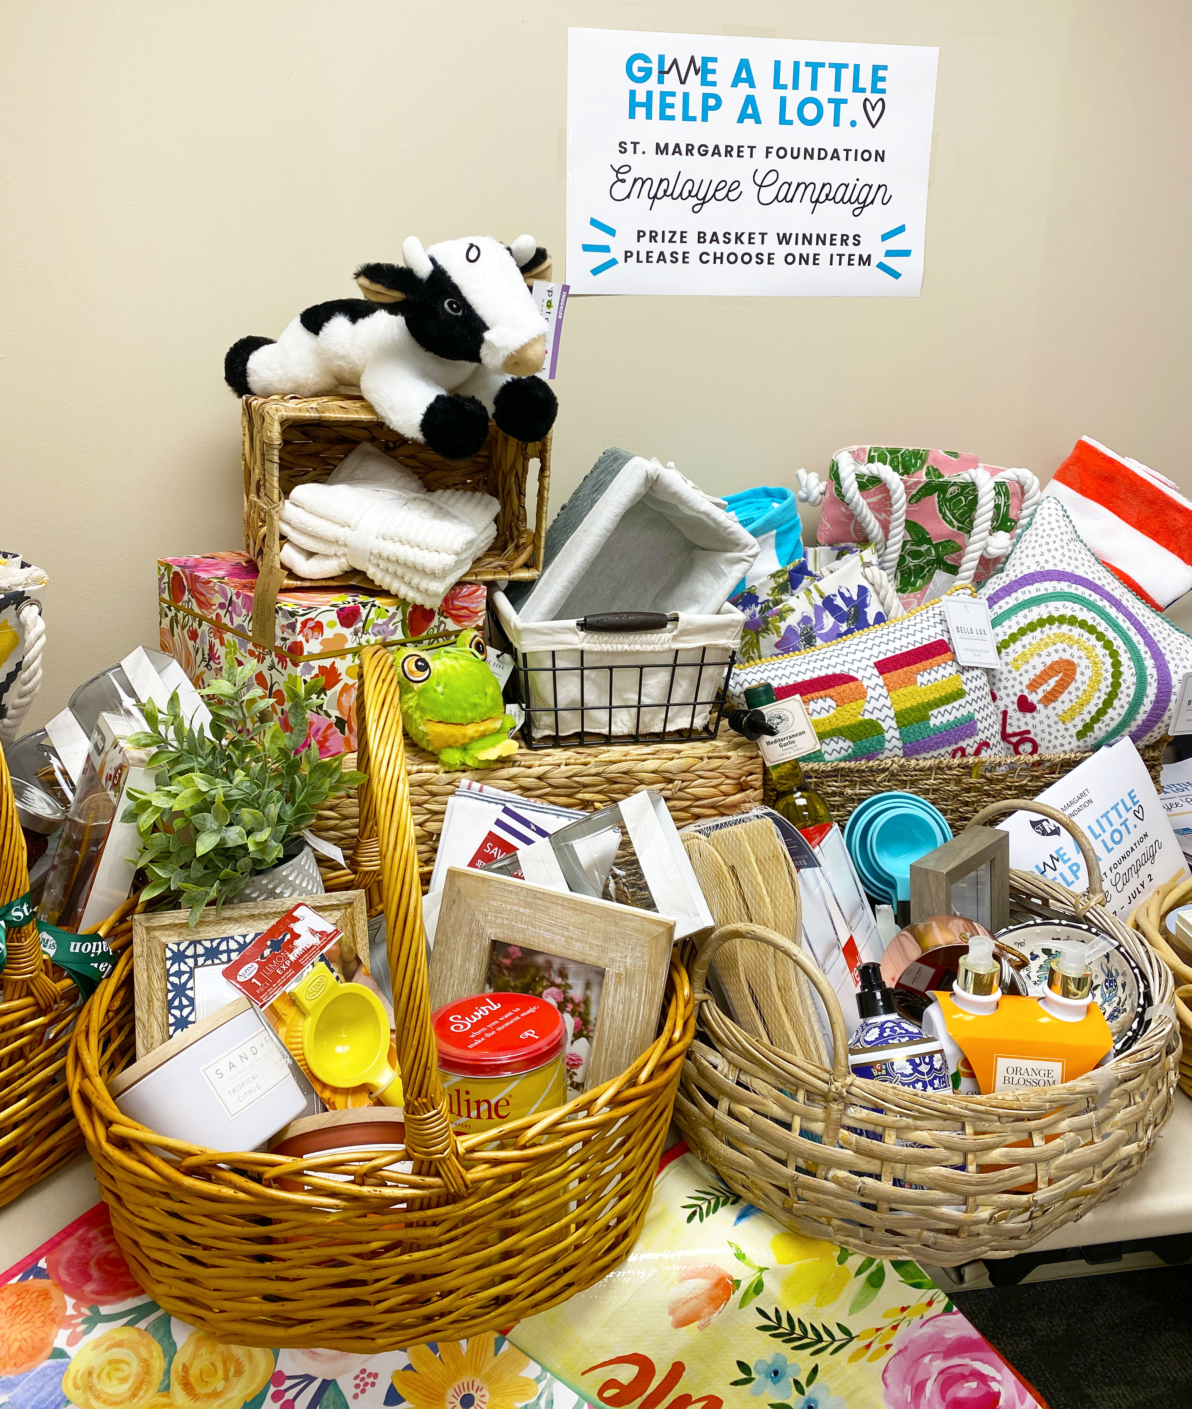
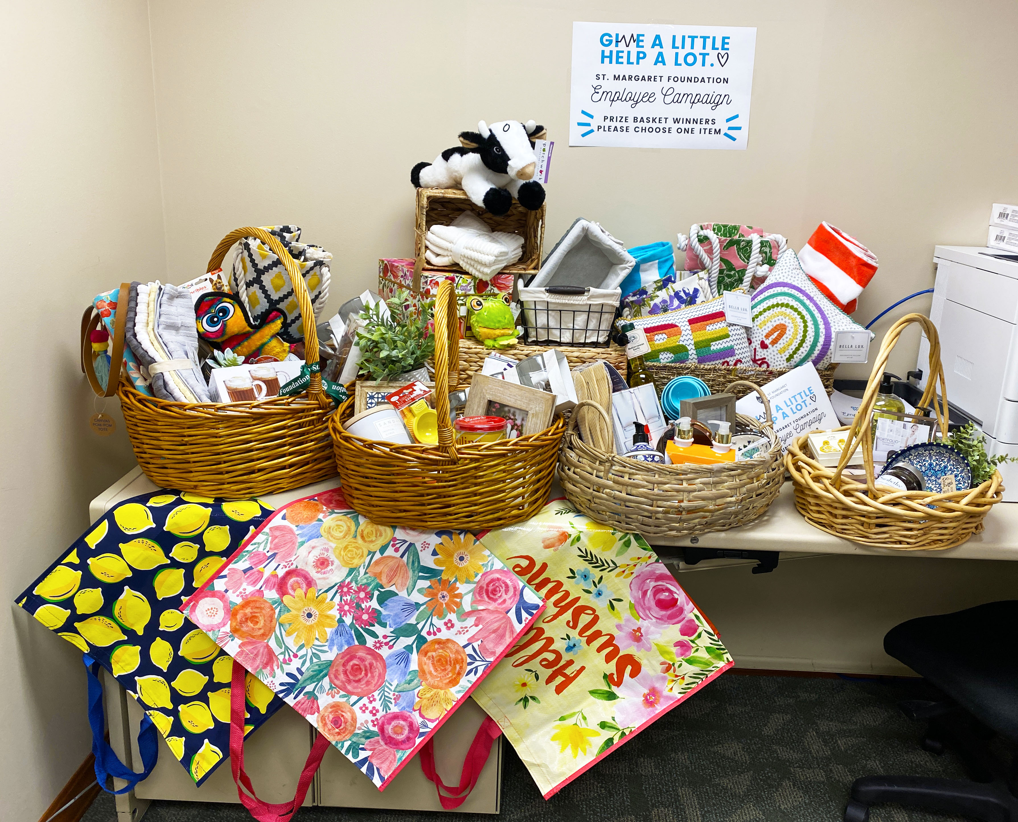
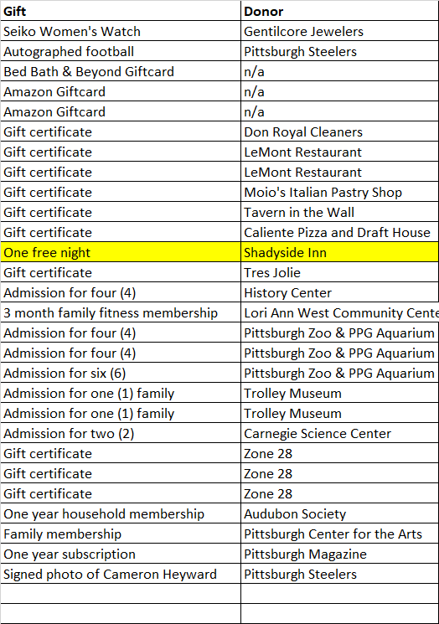
Turn in your pledge form by
June 18th for the Free Raffle!
$100 Amazon Gift Card
$200 Bed, Bath & Beyond Gift Card
$100 Amazon Gift Card

Slide 11
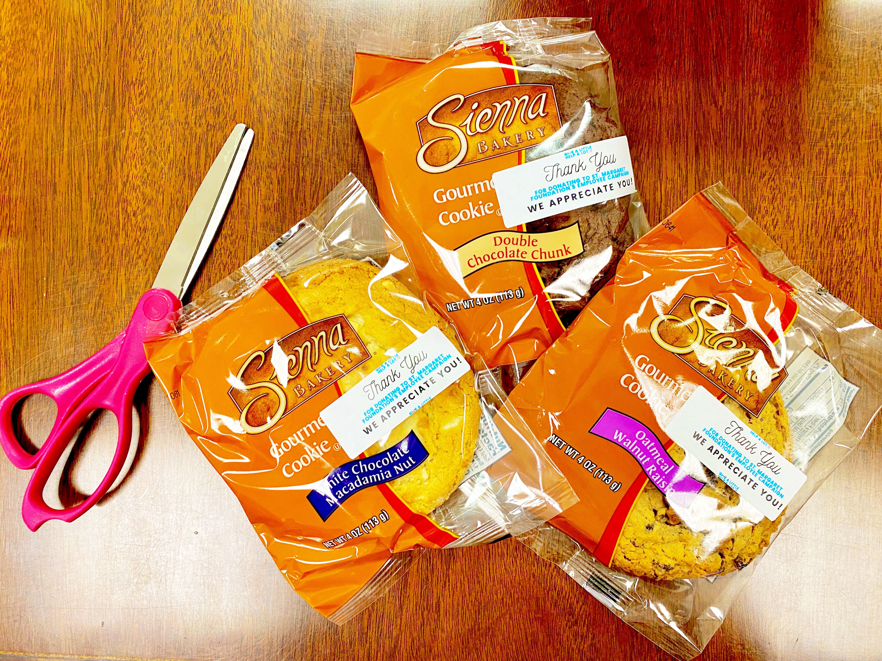
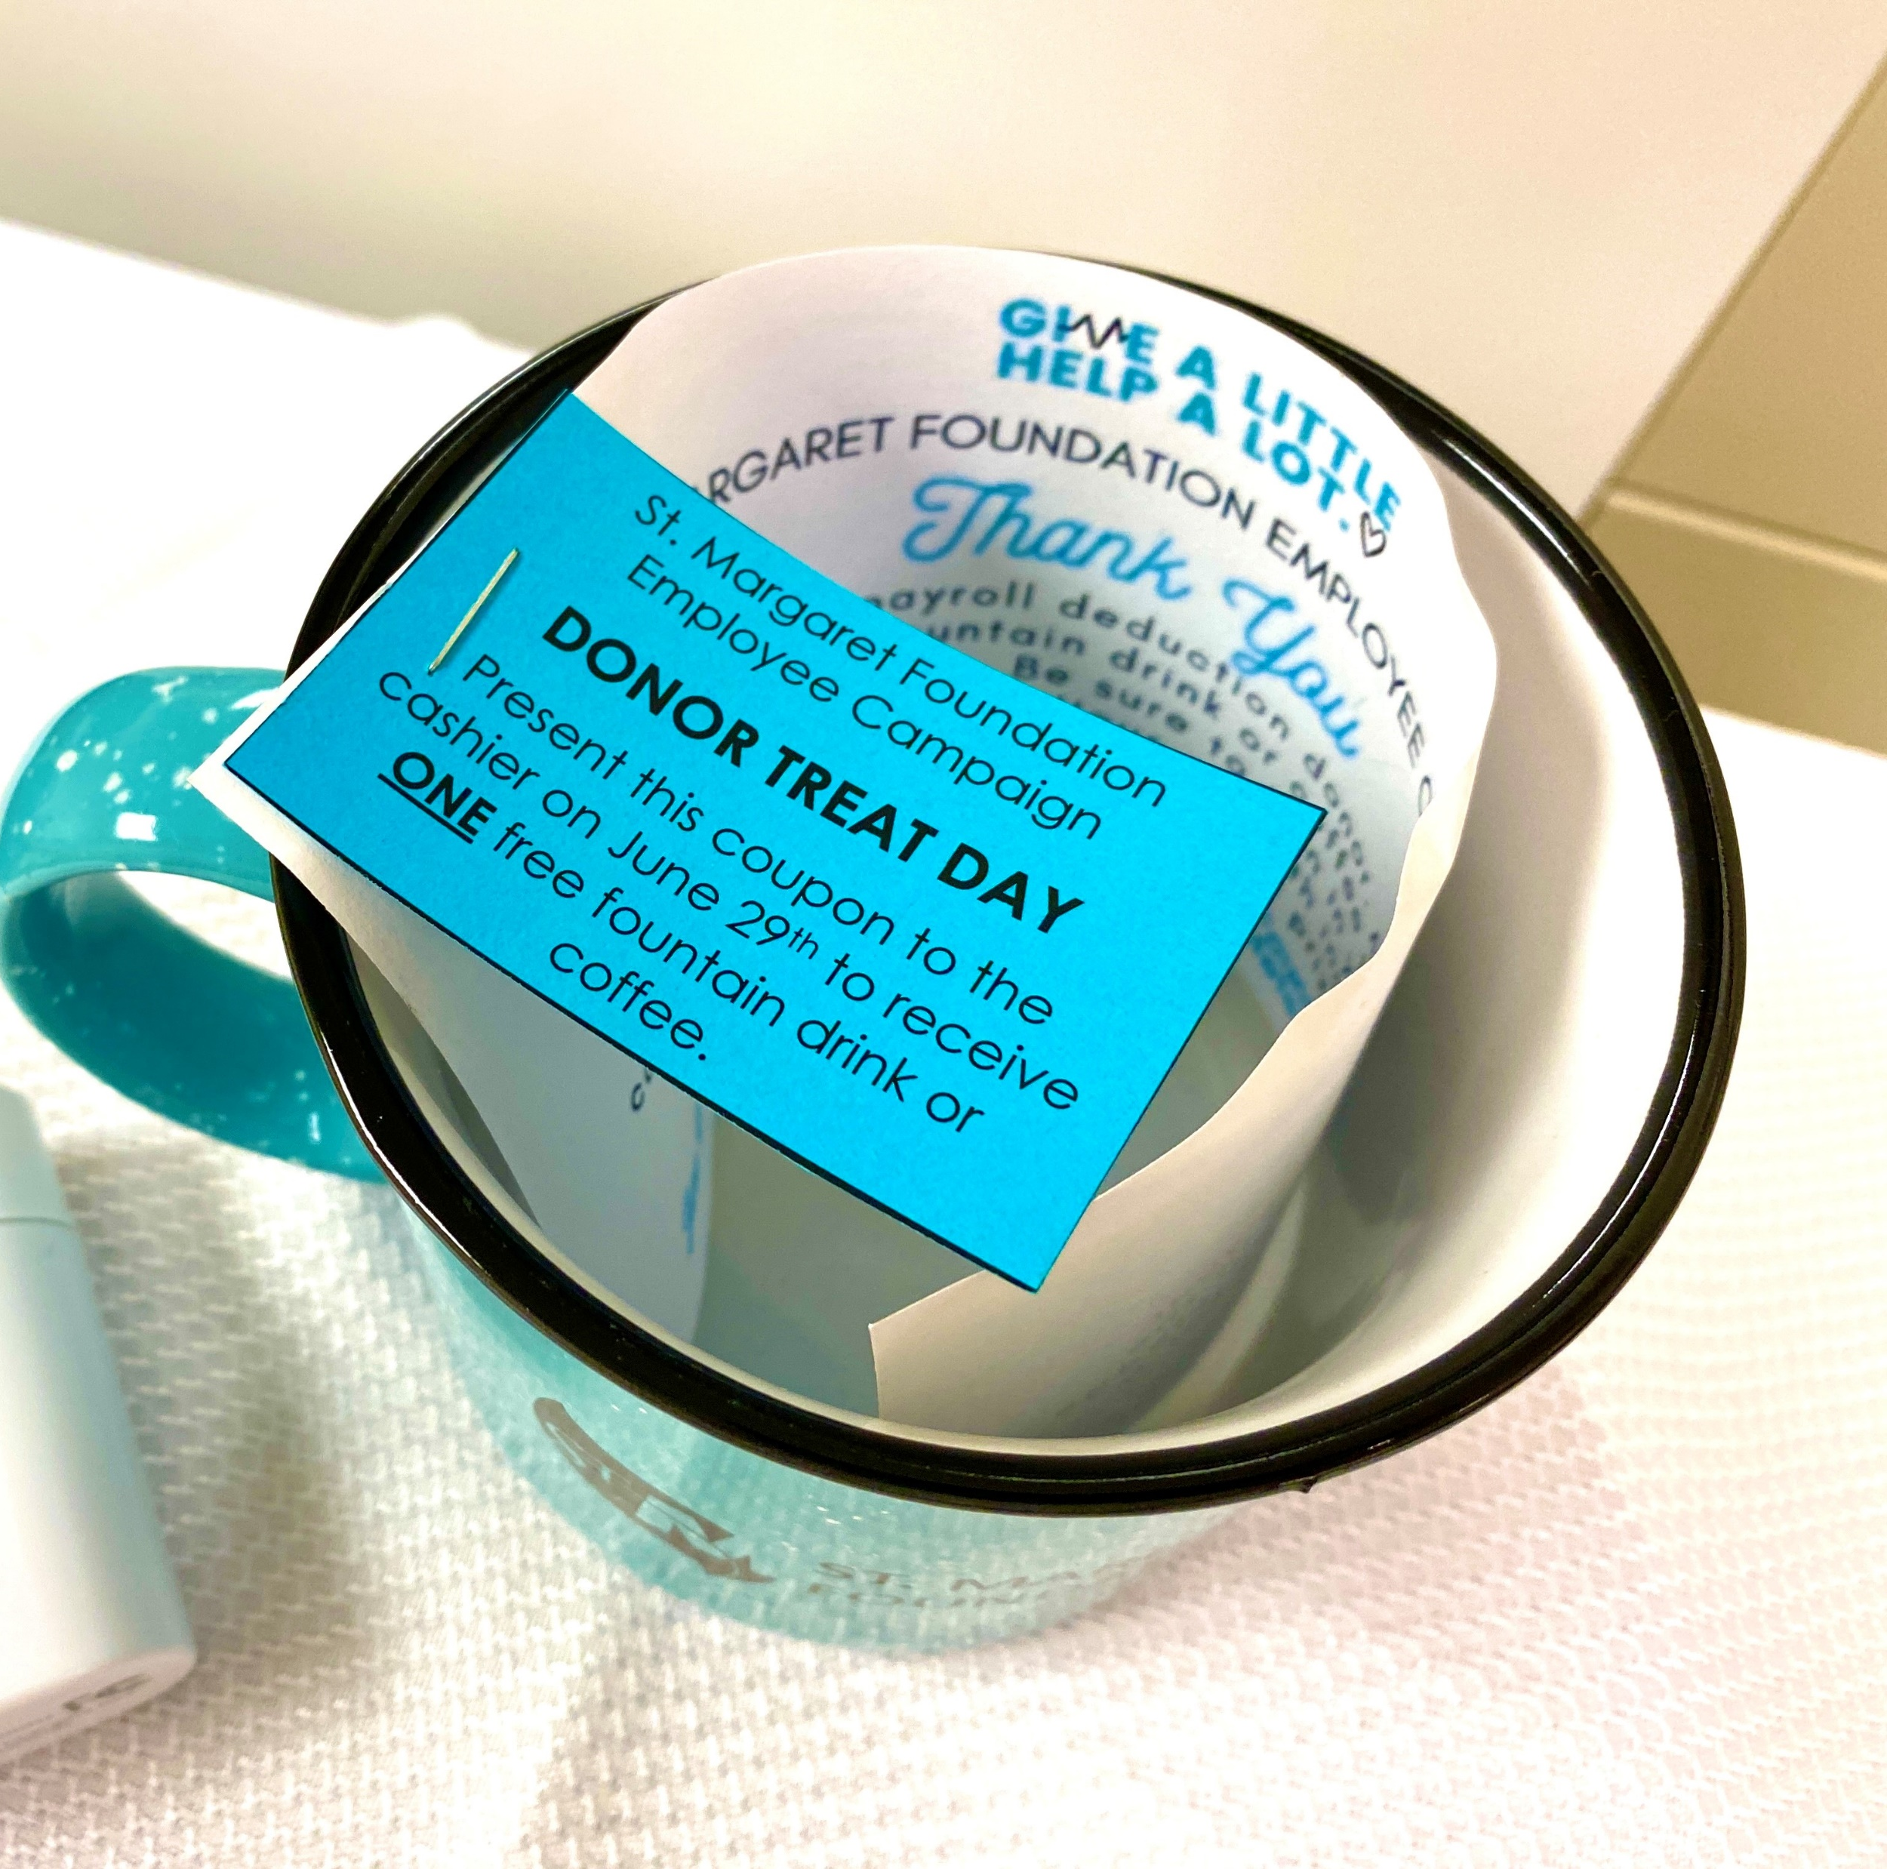

Slide 12
